Slide 1
IoT Farmbeats
By Team 28: Harry Chen, Szymon Duchniewicz, Angela Yu

Slide 2

User Requirements
Agricultural Research Scientist, age 22
1. What is your job like? What do you do?
As a Farm Research Scientist from a Research Council, I carry out fieldworks to gain insights to current farm processes. My goal is to optimize the process to increase crop yield for food sustainability. My research focuses on soil.
2. How do you collect the data? Do you have to travel directly to the farm to collect the data yourself?
Yes, I manually collect data, which is inconvenient since travelling from office to farm takes an hour every day. I place down the meters in the soil and take readings whilst I am at the farm to log data.
3. What kind of data will you be interested in having access to remotely?
I would love to have an improved infrastructure on data collection methods for factors such as soil pH, temperature and rainfall. I intend to use this to investigate the pollution level of the soil in order to help reduce its negative impact on plant growth.
4. In what form would you want data to be presented to help with your job?
A range of visualizations to choose from would be useful, for example pie charts and line graphs. I want to see how rainfall varies throughout the year and visualize relationships between factors that may affect the state of the soil over time.
5. What other features would you like to have in such a remote system?
Some pre-analysis of the data by trained models would help to predict costs, weather patterns, etc. A model that can predict characteristics of soils such as nutrient and water level based off data already collected would be very useful.
We contacted possible users for our product and conducted phone-call interviews to gain insight of their requirements. All interviewees signed a consent form before participating.
Farmer, age 70
1. Do current farmers have a remote way to monitor farm’s situation? If yes, what's that, and do you find it useful? If not, what's something that you would want if possible?
We do have some remote ways to monitor the farm such as cameras, but it's only used for monitor if there's any thief or animals that may damage the plants. We would want more devices that can monitor factors in the farm such as luminosity and temperature.
2. How proficient are you with software operations?
I have a smart phone, but I only use it for WeChat and phone calls, but my son can operate them quite well, I think.
3. How do you monitor and find out the situation of plant growth at the farm?
Basically, what I used to do is to go down to the farm and see the situation with my hands and eyes.
4. How often do you monitor the situation at the farm?
At least once a day at morning.
5. What's the size of your field and how many times would you need to organize them everyday?
My land for wheat is half a MU, and there's also half a MU for corn, about quatre a MU for potato and other vegetables. (MU is a Chinese Unit of area, equal to 1/15 of a hectare or 1/6 an acre)

Slide 3
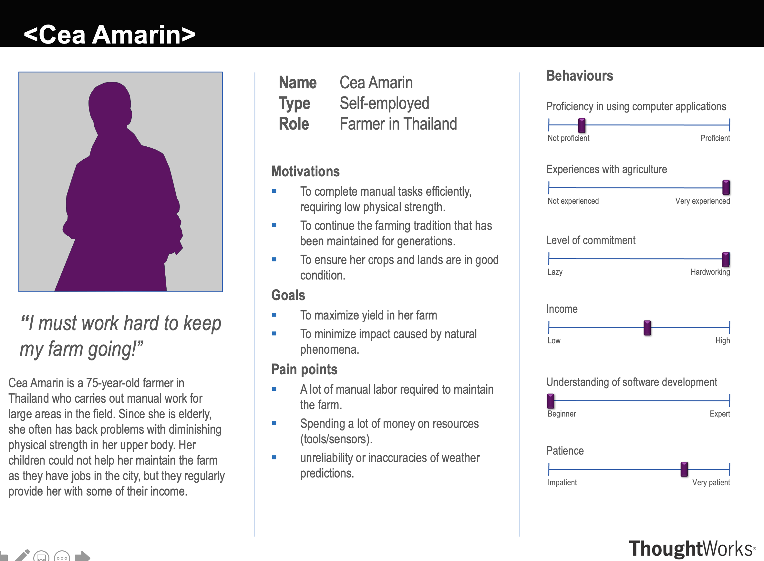
Persona and Scenario 1
Scenario
Cea is a 75-year-old farmer who is very experienced with agriculture. She wants to find a way to maintain the farm by herself, as she is elderly and finds herself lacking physical strength after working for a long time. She mounted our devices to the farm and logged into our web-app to monitor the situation of the field. Does this easily by seeing data and charts on the website. She also connects her original watering device into the system so she can finish her daily job at home on her own. She is also able to determine the situation by the color of the indicator light on the web-app and follows suggestions given which are determined by our model. This makes her work life more convenient and simpler.

Slide 4
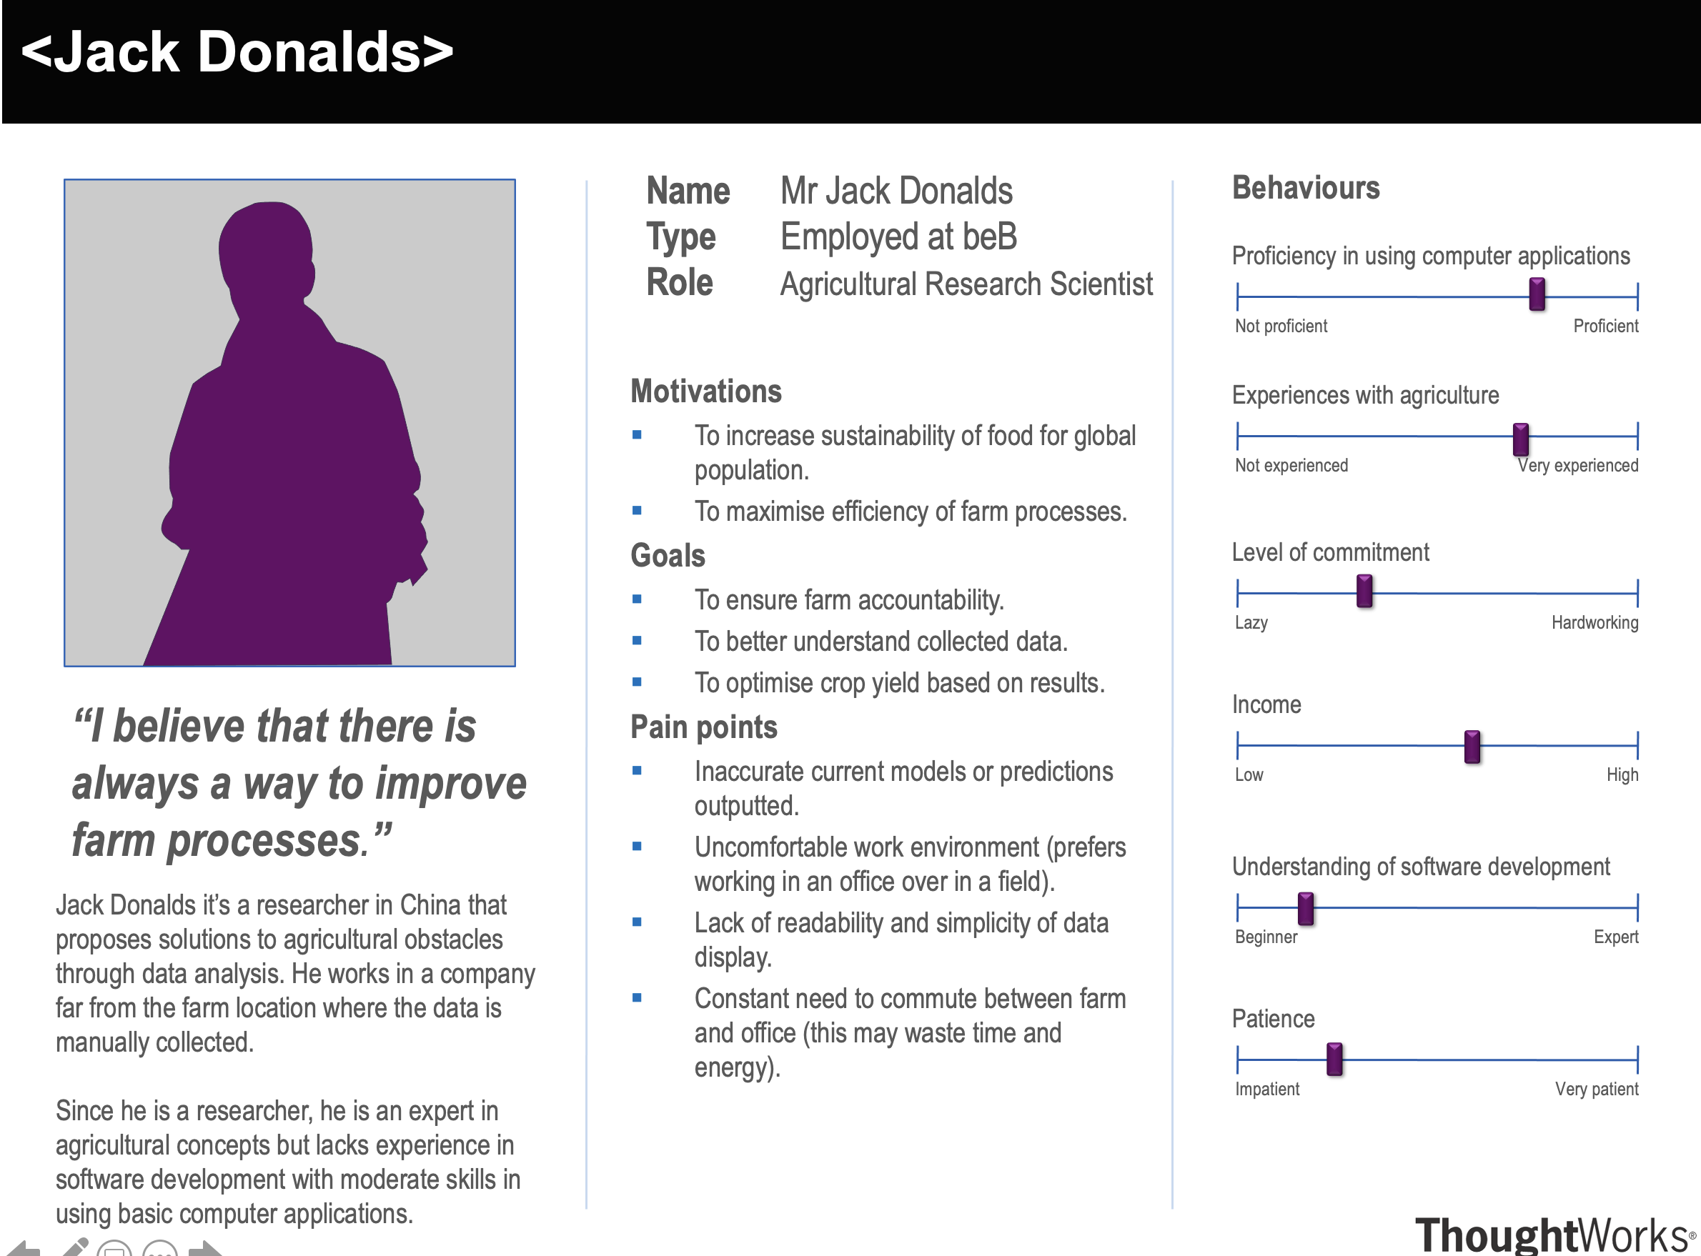
Persona and Scenario 2
Scenario (used [1] and [2] for reference)
Jack Donalds is a 35-year-old agricultural research scientist and is quite experienced with using electronic devices and computer systems. He wants to collect some data on soil humidity and ambient temperature on the farm he is using as his case study. He accesses the farm's website on his computer, and briefly looks through all data shown on the first page to look for any anomalies. Satisfied that there aren't any error messages indicating problems, he selects an option to display ambient temperature against time on a graph. Satisfied with the data values, he downloads the data as an XML file and uses it for further analysis offline.

Slide 5
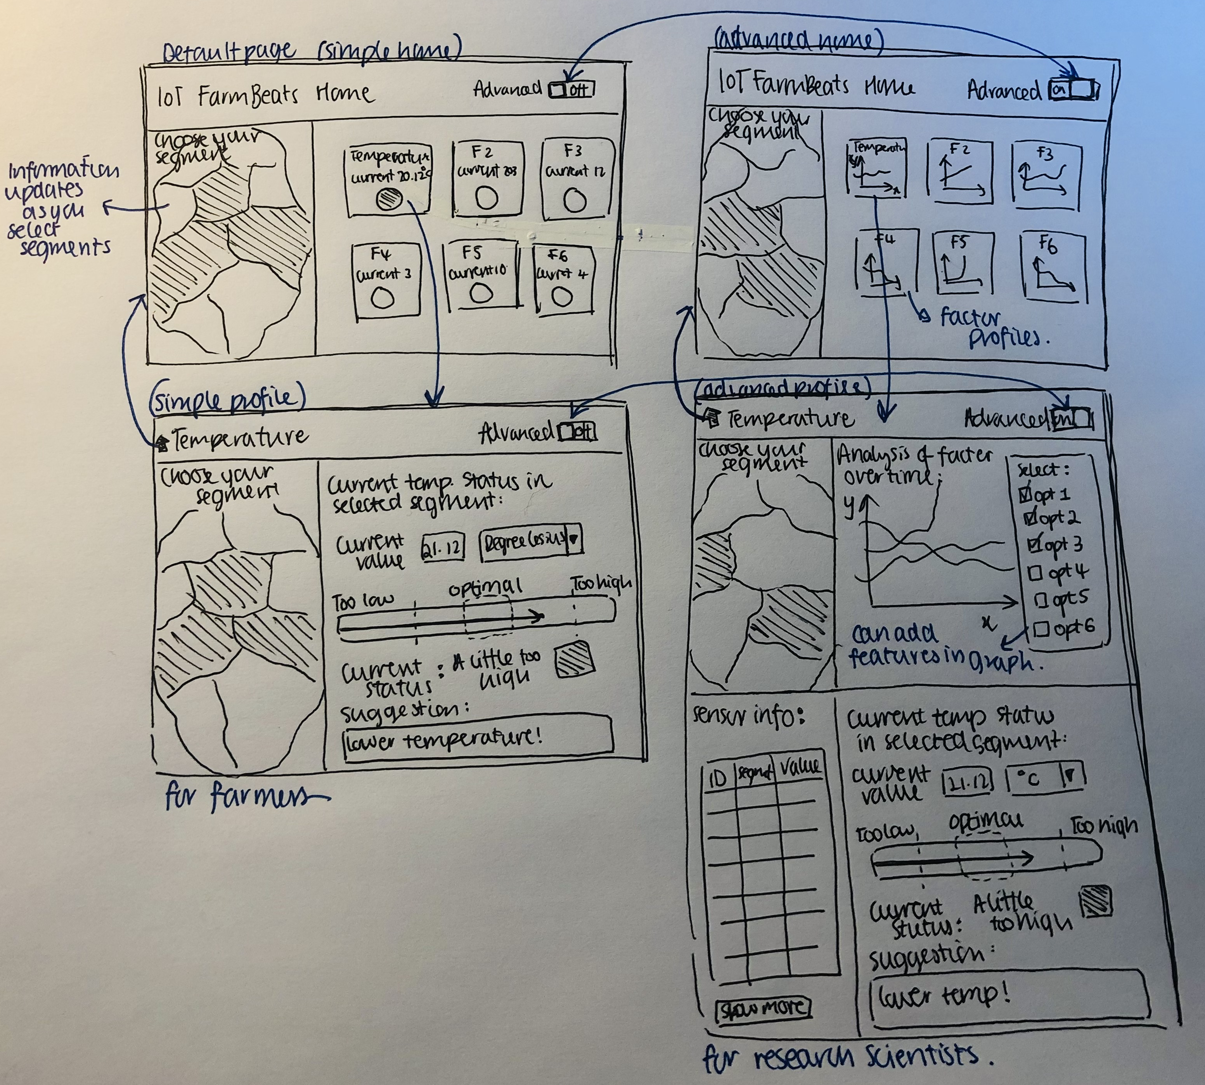
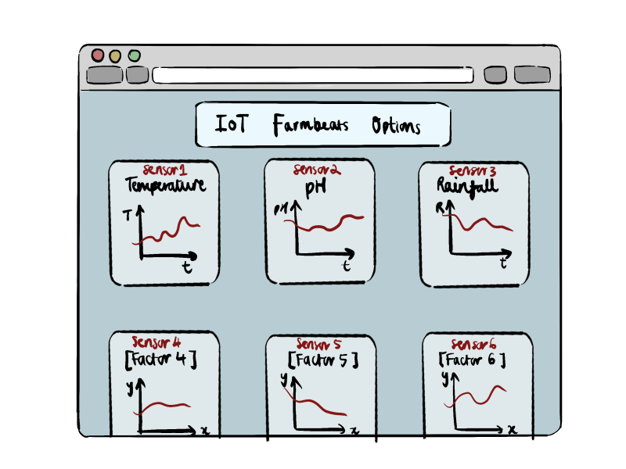
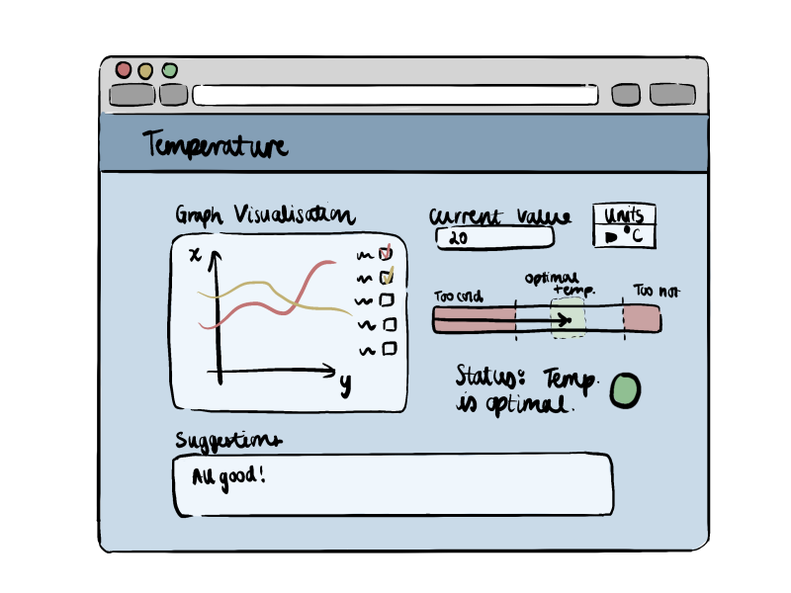
Alternative Sketch Designs
There is a menu page for user to select a factor they are interested in, which takes user to a factor profile page with all the relevant information.
Farm segment selection feature added to allow information from specific sections of the farm to be seen/hidden.
Simple/Advanced view: Splitting data visualization for farmers and research scientist as they require information at different levels of detail.
Sketch 2 (after user review)
Sketch 1

Slide 6

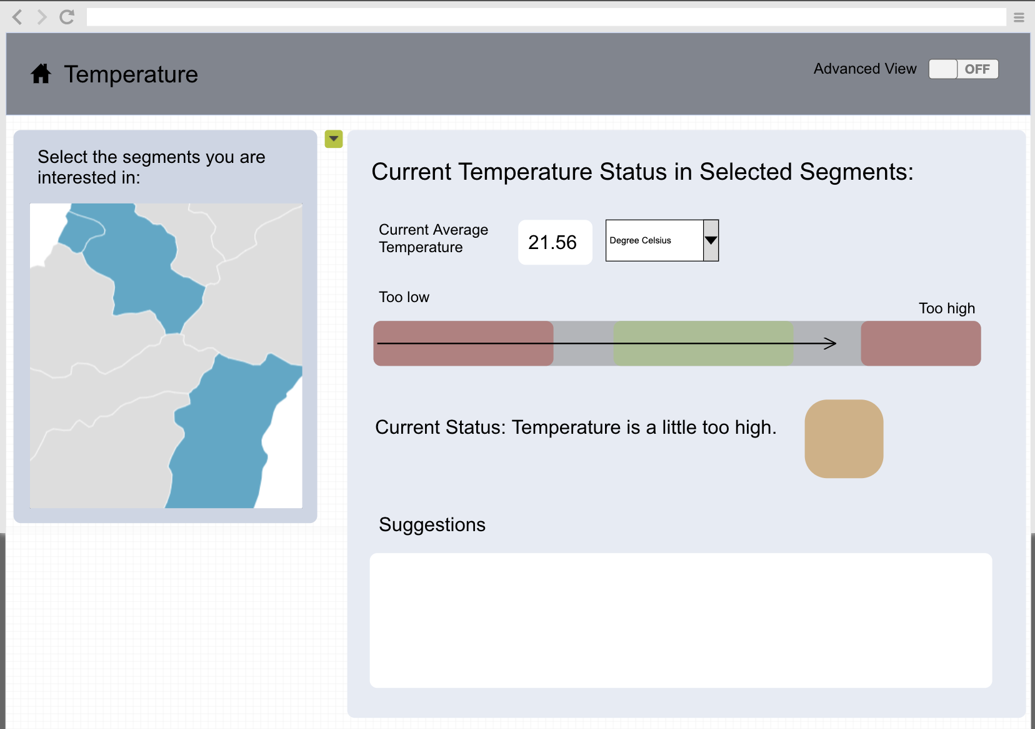
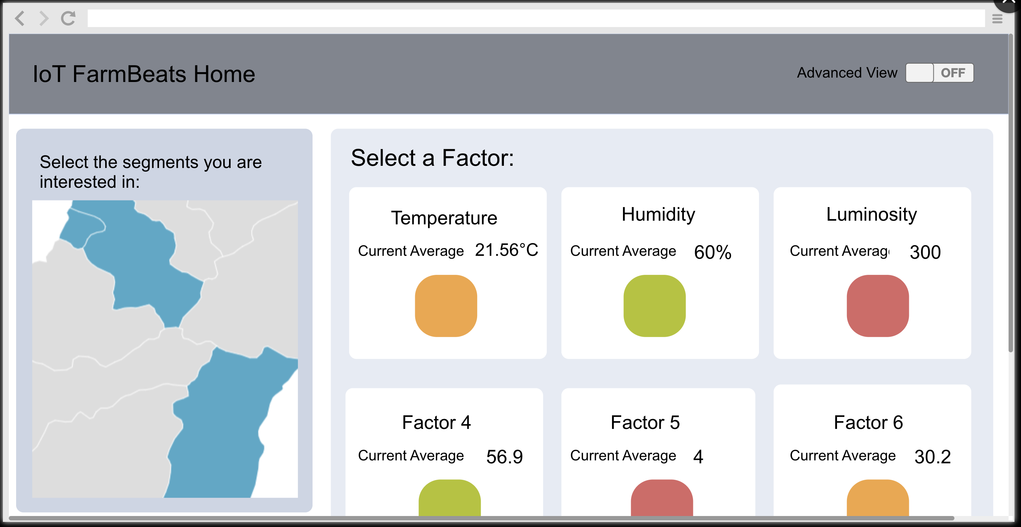
Prototype for Simple View
To profile page advanced view
Based on sketch 2: Simple view of the website is targeted for farmers and advanced view is for research scientists. The simple home page is set as the default page.
To home page advanced view
Click on region to toggle selection.
Drop down menu for unit selection

Slide 7

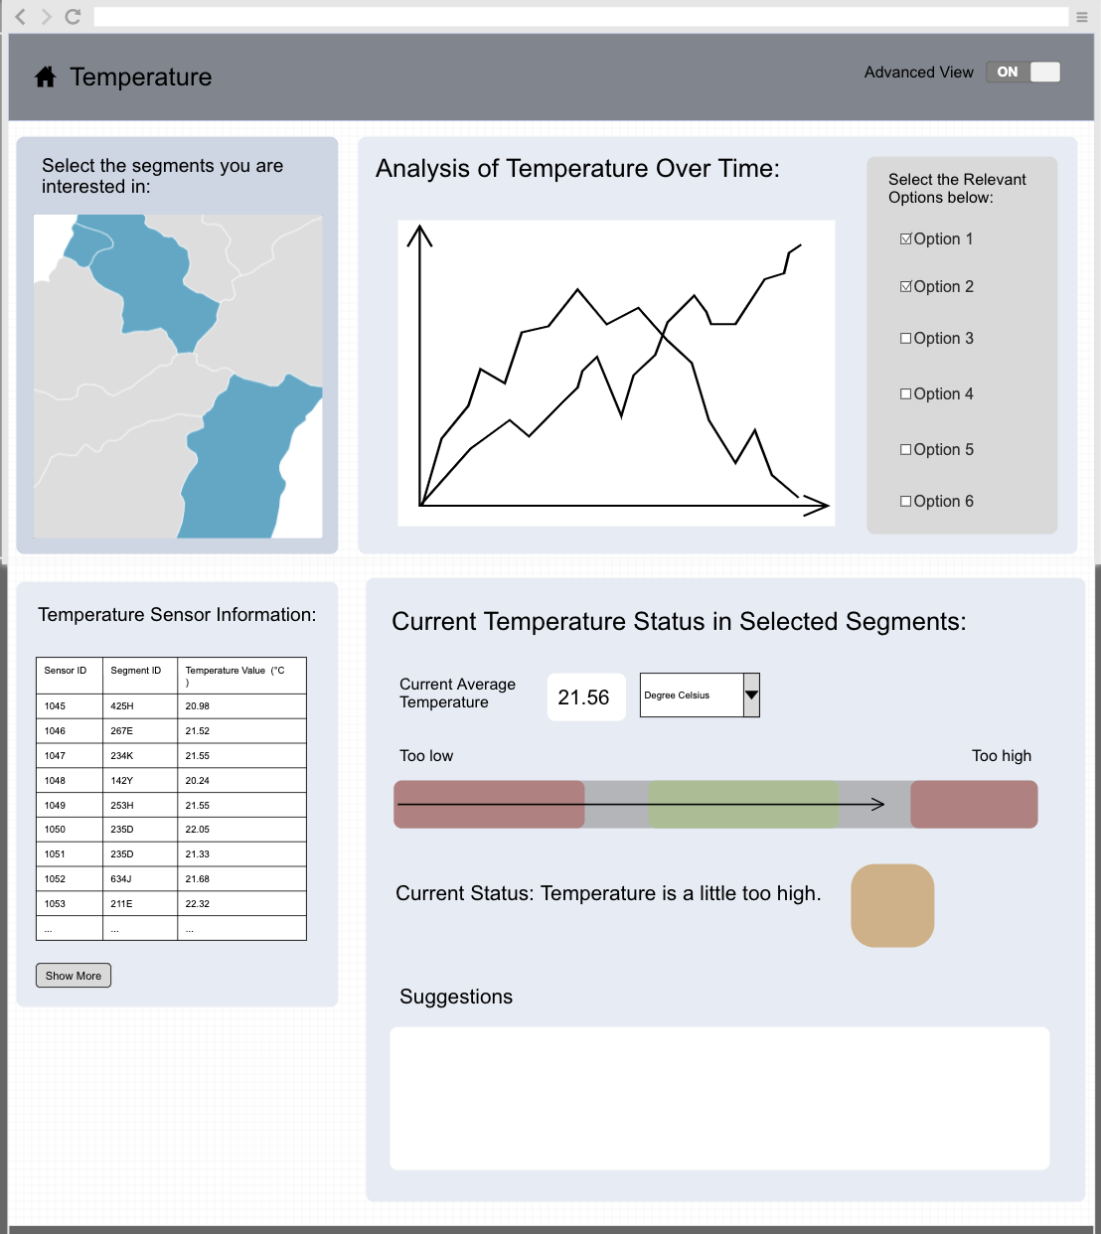
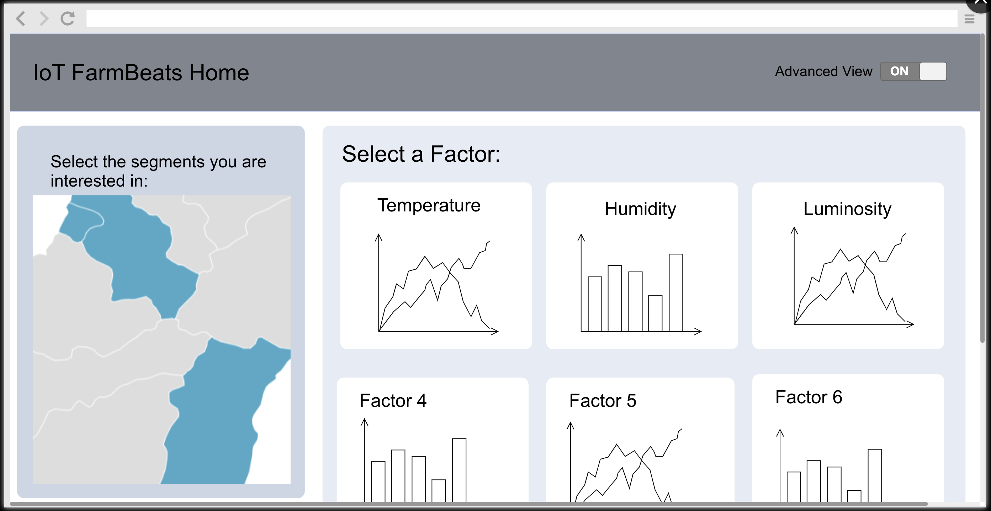
Prototype for Advanced View
To profile page simple view
To toggle graph features
To home page simple view
To view more sensor information

Slide 8

Evaluation
Heuristic | Problem | Solution | Severity
Flexibility and efficiency of use | The data log page should provide a search button to search through time/value data the user wants and look through older data. | Search input bar and button added. | 2
User control and freedom | For segment selection allow user to select all or deselect all segments in one click. | Add ‘select all’ and ’deselect all’ button to the map. | 1
 | Allow user to save data in XML format for offline use. | Add ‘download XML’ button. | 3
Aesthetic and minimalist design | For advanced view, the indicator light for current status is not necessary for the research scientist. | Indicator light removed. | 2

Slide 9
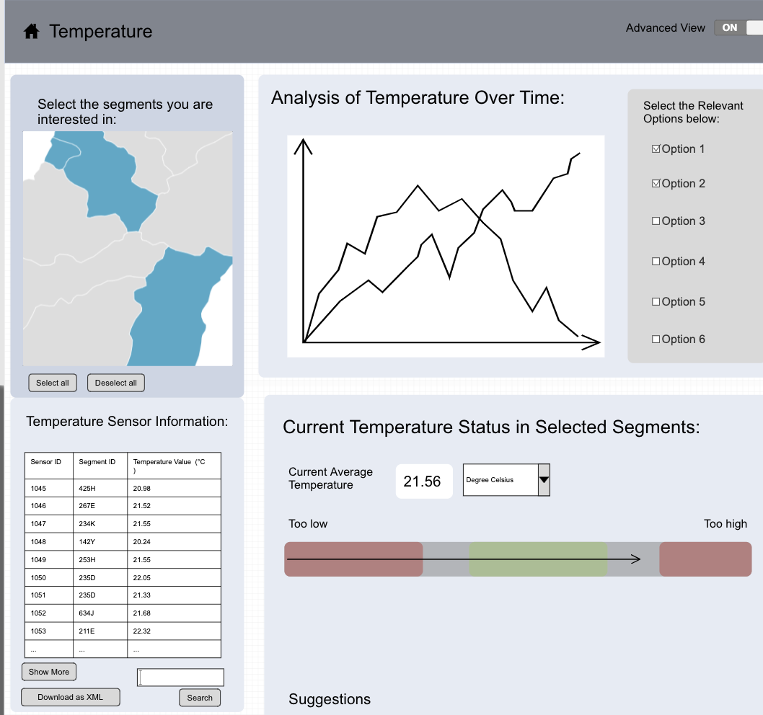

Improvements
This page shows all improvements mentioned in the evaluation which has been updated for all other pages in a similar manner.
Selects all regions on the map
Deselects all regions on the map
Removed indicator light (only for advanced view)
Interactable textbox for search query
Search for Sensor ID based on input above
Download XML file of data

Slide 10
References
[1] "What is a Plant and Soil Scientist?," [Online]. Available: https://www.environmentalscience.org/career/soil-and-plant-scientist. [Accessed November 2021].
[2] "Careers Wales," [Online]. Available: https://careerswales.gov.wales/job-information/agricultural-research-scientist/job-role . [Accessed November 2021].

